Slide 1
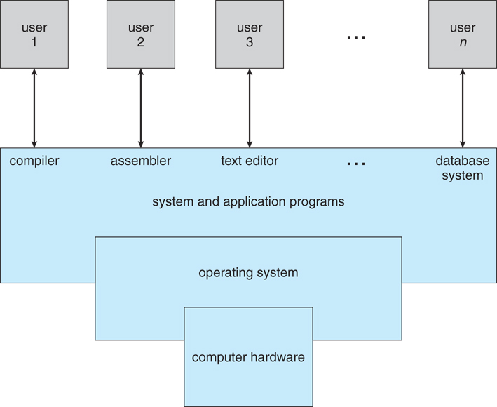
Operating Systems
Weeks 1–3
AR332 • Theory
Syed Nisar Ali
Principal Lecturer, UCP
AR332 01
Notes:
TEACHING NOTES
Teaching pack aligned with the uploaded course outline. Use the recap only as needed. Five proposed remaining 60-minute sessions cover Week 1 continuation, Week 2 A/B and Week 3 A/B. All examples assume one execution thread per process unless stated otherwise.
SOURCES
https://os-book.com/OS9/slide-dir/index.html
https://www.cs.uic.edu/~jbell/CourseNotes/OperatingSystems/images/Chapter1/1_1_SystemComponents.jpg
Original classroom explanations and exercises by this teaching adaptation. Source figures retained with acknowledgement. Charts show hypothetical examples, not measured performance.

Slide 2
Lecture route
Week 1 recap: OS role, boot and architecture
Week 1 continuation: sharing, interrupts and protection
Week 2: services, interfaces and kernel design
Week 3: processes, queues and context switching
AR332 02
Notes:
TEACHING NOTES
Learning outcomes map to CLO1: explain OS structure, characteristics and core functions. The outline lists two Week 1 entries and two Week 2 entries. Treat them as two teaching blocks per week. Week 3 divides naturally into process basics and scheduling mechanisms. Detailed scheduling algorithms belong to Week 7.
SOURCES
https://os-book.com/OS9/slide-dir/index.html
Original classroom explanations and exercises by this teaching adaptation. Source figures retained with acknowledgement. Charts show hypothetical examples, not measured performance.

Slide 3
Recap: why an operating system?
Applications compete for limited resources.
The OS allocates CPU time and memory.
It offers useful abstractions such as files.
It controls access to shared hardware.
Week 1 03
Notes:
TEACHING NOTES
Ask: two applications want the same printer. Who decides the order? The OS and its services coordinate access. Distinguish the kernel, which executes privileged core functions, from the broader OS including tools and services. Spend no more than two minutes here if already taught.
SOURCES
https://os-book.com/OS9/slide-dir/index.html
Original classroom explanations and exercises by this teaching adaptation. Source figures retained with acknowledgement. Charts show hypothetical examples, not measured performance.

Slide 4
Recap: system boot
Firmware starts after power-on.
A boot path locates and loads the kernel.
The kernel initializes memory and devices.
An initial user-space process starts services.
Week 1 04
Notes:
TEACHING NOTES
Explain a typical PC/Linux boot: firmware, boot manager or bootloader, kernel, optional initramfs, then init/systemd and services. Exact stages differ by platform. Firmware exists before the disk OS runs. Ask whether the kernel can load itself before any code is running. Answer: earlier boot code performs that work.
SOURCES
https://os-book.com/OS9/slide-dir/index.html
Original classroom explanations and exercises by this teaching adaptation. Source figures retained with acknowledgement. Charts show hypothetical examples, not measured performance.

Slide 5
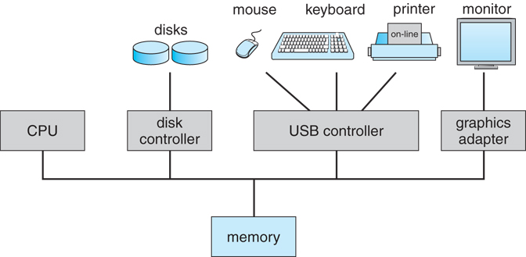
Recap: CPU, memory and devices
Device controllers operate alongside the CPU.
Controllers report events through interrupts.
Drivers provide software control of devices.
Figure: Operating System Concepts, 9th ed., ©2013, via UIC course notes
Week 1 05
Notes:
TEACHING NOTES
Walk through a disk read without diving into device protocols. A driver issues a command. The controller handles the device operation and later reports completion. CPU and device work can overlap even on a single-core computer. The illustration is a conceptual bus-based system, not a claim that every modern machine has one physical bus.
SOURCES
https://os-book.com/OS9/slide-dir/index.html
https://www.cs.uic.edu/~jbell/CourseNotes/OperatingSystems/images/Chapter1/1_2_ModernSystem.jpg
Original classroom explanations and exercises by this teaching adaptation. Source figures retained with acknowledgement. Charts show hypothetical examples, not measured performance.

Slide 6
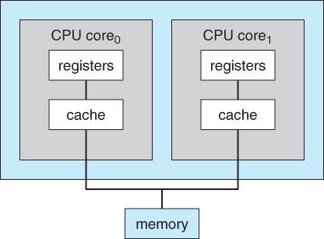
Recap: processor architecture
One core can interleave several tasks.
Several cores can execute tasks in parallel.
Shared-memory multiprocessors share RAM.
Figure: Operating System Concepts, 9th ed., ©2013, via UIC course notes
Week 1 06
Notes:
TEACHING NOTES
Distinguish CPU package, core and logical processor. In the introductory model, each execution unit runs one thread at a time. SMT adds logical processors and complicates the physical-core picture. Do not present multiprocessing as a mandatory stage after multitasking. They describe different properties.
SOURCES
https://os-book.com/OS9/slide-dir/index.html
https://www.cs.uic.edu/~jbell/CourseNotes/OperatingSystems/images/Chapter1/1_7_DualCore.jpg
Original classroom explanations and exercises by this teaching adaptation. Source figures retained with acknowledgement. Charts show hypothetical examples, not measured performance.

Slide 7
WEEK 1
Week 1: sharing and protection
Explain three ways programs make progress.
Classify interrupts and exceptions.
Trace interrupt handling.
Explain memory, I/O and CPU protection.
Week 1 07
Notes:
TEACHING NOTES
Proposed session: 5 minutes recap, 15 minutes sharing and worked example, 15 minutes interrupts, 15 minutes protection, 10 minutes retrieval practice. Start here if Week 1 introduction is complete.
SOURCES
https://os-book.com/OS9/slide-dir/index.html
Original classroom explanations and exercises by this teaching adaptation. Source figures retained with acknowledgement. Charts show hypothetical examples, not measured performance.

Slide 8
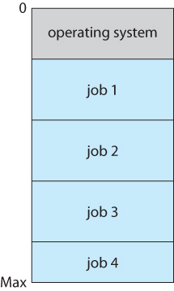
Multiprogramming
Several jobs are available to run.
When one waits for I/O, another uses the CPU.
The main aim is to reduce CPU idle time.
Figure: Operating System Concepts, 9th ed., ©2013, via UIC course notes
Week 1 08
Notes:
TEACHING NOTES
Use a teacher analogy: while one student solves a calculation, the teacher helps another. Avoid defining multiprogramming as inherently non-preemptive. Early batch implementations often switched on blocking, but the concept does not prohibit preemption. With virtual memory, available processes need not have every byte resident in RAM.
SOURCES
https://os-book.com/OS9/slide-dir/index.html
https://www.cs.uic.edu/~jbell/CourseNotes/OperatingSystems/images/Chapter1/1_9_MemoryLayout.jpg
Original classroom explanations and exercises by this teaching adaptation. Source figures retained with acknowledgement. Charts show hypothetical examples, not measured performance.

Slide 9
Worked example: CPU utilization
A needs 4 ms CPU, 6 ms I/O, then 2 ms CPU.
B needs 6 ms CPU and is ready at time 0.
One core. Ignore switch overhead.
How much CPU time becomes useful work?
Interval | One job at a time | Both jobs available
0–4 ms | A | A
4–10 ms | CPU idle, A in I/O | B, A in I/O
10–12 ms | A | A
12–18 ms | B | All work complete
Week 1 09
Notes:
TEACHING NOTES
Serial baseline: A runs 0–4, CPU idles 4–10, A runs 10–12, B runs 12–18. Useful CPU work is 12/18 = 66.7%. Multiprogramming: A runs 0–4, B runs 4–10 during A I/O, A runs 10–12. Useful work is 12/12 = 100%. This is an illustrative workload, not a measured benchmark. Both processes arrive at 0 and the baseline deliberately admits one at a time.
SOURCES
https://os-book.com/OS9/slide-dir/index.html
Original classroom explanations and exercises by this teaching adaptation. Source figures retained with acknowledgement. Charts show hypothetical examples, not measured performance.

Slide 10
Worked example: utilization result
The same 12 ms of CPU work finishes sooner.
Overlapping B with A’s I/O removes 6 ms idle time.
Illustrative workload: 12 ms useful CPU work, with switch overhead ignored
Week 1 10
Notes:
TEACHING NOTES
Reveal after students calculate. Useful CPU utilization is useful CPU time divided by elapsed completion time. Actual systems incur scheduler and context-switch costs. The chart values come entirely from the preceding example.
SOURCES
https://os-book.com/OS9/slide-dir/index.html
Original classroom explanations and exercises by this teaching adaptation. Source figures retained with acknowledgement. Charts show hypothetical examples, not measured performance.

Slide 11
Multitasking and time sharing
The OS interleaves tasks for responsiveness.
Preemptive systems can stop a runnable task.
Timer interrupts let the OS regain control.
Cooperative systems rely on tasks yielding.
Week 1 11
Notes:
TEACHING NOTES
Illustrate A runs 0–10 ms, B 10–20 ms, A 20–30 ms. These are arbitrary teaching time slices. Time-sharing systems commonly support interactive users. A task can block before its quantum ends. A timer interrupt does not necessarily force a process change every time. Multitasking is broader than fixed round-robin scheduling.
SOURCES
https://os-book.com/OS9/slide-dir/index.html
Original classroom explanations and exercises by this teaching adaptation. Source figures retained with acknowledgement. Charts show hypothetical examples, not measured performance.

Slide 12
Three related concepts
The properties can coexist in one OS.
Concept | Primary idea | Needs multiple cores?
Multiprogramming | Keep work available during waits | No
Multitasking | Interleave tasks to share CPU time | No
Multiprocessing | Use multiple execution units | Yes, in this teaching model
Week 1 12
Notes:
TEACHING NOTES
Example: a four-core laptop keeps many processes available, interleaves more runnable tasks than cores, and executes several tasks in parallel. Ask: does music plus a browser prove the machine has two cores? No. Concurrent progress is possible on one core.
SOURCES
https://os-book.com/OS9/slide-dir/index.html
Original classroom explanations and exercises by this teaching adaptation. Source figures retained with acknowledgement. Charts show hypothetical examples, not measured performance.

Slide 13
Interrupts and exceptions
Hardware interrupts usually arrive asynchronously.
Instruction-caused exceptions are synchronous.
Software instructions can request kernel entry.
Week 1 13
Notes:
TEACHING NOTES
Asynchronous means independent of the current instruction, not that interrupts have no timing. Synchronous means tied to execution of an instruction. Introductory OS texts sometimes use trap broadly for software-caused entry. Intel uses more specific fault/trap/abort exception classes. A Linux signal is an OS notification mechanism, not a hardware interrupt.
SOURCES
https://os-book.com/OS9/slide-dir/index.html
Original classroom explanations and exercises by this teaching adaptation. Source figures retained with acknowledgement. Charts show hypothetical examples, not measured performance.

Slide 14
Interrupt, trap and fault
Terminology depends on the architecture.
Event | Example | Normal return point
Hardware interrupt | Timer or device completion | Resume interrupted execution
Trap-class exception (x86) | INT3 breakpoint | After trapping instruction
Fault-class exception (x86) | Page fault | Retry faulting instruction if fixed
Week 1 14
Notes:
TEACHING NOTES
Use Intel x86 meanings in the table. A fault saves a restart point at the faulting instruction. A trap reports after the trapping instruction. INT3 is a trap-class exception. A system call is an intentional synchronous kernel request, but SYSCALL is not an Intel trap-class exception. Aborts may prevent reliable restart. Intentional versus accidental is not the precise trap/fault definition.
SOURCES
https://os-book.com/OS9/slide-dir/index.html
https://cdrdv2-public.intel.com/868137/325462-089-sdm-vol-1-2abcd-3abcd-4.pdf (Vol. 3A, exception classifications)
Original classroom explanations and exercises by this teaching adaptation. Source figures retained with acknowledgement. Charts show hypothetical examples, not measured performance.

Slide 15
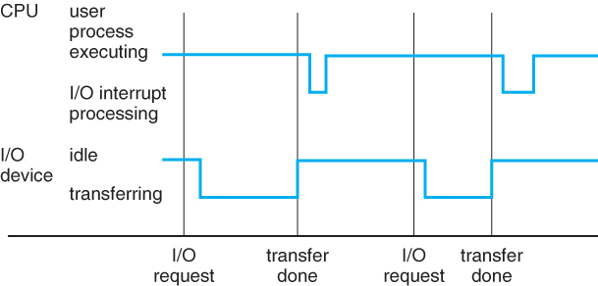
Interrupt service mechanism
Hardware identifies an event.
The CPU saves architectural state and enters a handler.
The handler services or acknowledges the source.
Return restores execution state.
Figure: Operating System Concepts, 9th ed., ©2013, via UIC course notes
Week 1 15
Notes:
TEACHING NOTES
Hardware saves some state and entry code saves other registers. The exact division depends on architecture and OS. Explain vector or descriptor tables conceptually. Device-specific work may be deferred. Return may resume the original process or the scheduler may select another. Avoid saying every interrupt saves an entire PCB in hardware.
SOURCES
https://os-book.com/OS9/slide-dir/index.html
https://www.cs.uic.edu/~jbell/CourseNotes/OperatingSystems/images/Chapter1/1_3_InterruptTimeLine.jpg
Original classroom explanations and exercises by this teaching adaptation. Source figures retained with acknowledgement. Charts show hypothetical examples, not measured performance.

Slide 16
A recoverable page fault
A load accesses a valid page absent from RAM.
The CPU raises a page-fault exception.
The OS makes the page available and updates mapping.
The CPU retries the same load.
Week 1 16
Notes:
TEACHING NOTES
Conceptual instruction: load value at virtual address 0x5000. A valid nonresident page may require disk I/O, zero allocation or another action. An illegal access can also cause a page fault and may lead to process termination. A page fault is not always an error in the program and not always a disk read. Detailed paging belongs to Weeks 12–14.
SOURCES
https://os-book.com/OS9/slide-dir/index.html
https://cdrdv2-public.intel.com/868137/325462-089-sdm-vol-1-2abcd-3abcd-4.pdf (Vol. 3A, exception classifications)
Original classroom explanations and exercises by this teaching adaptation. Source figures retained with acknowledgement. Charts show hypothetical examples, not measured performance.

Slide 17
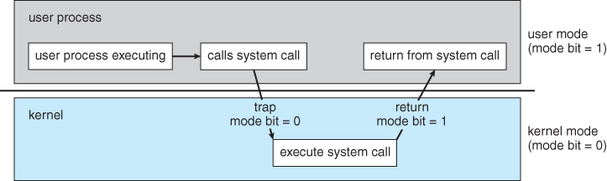
User mode and kernel mode
User code runs with restricted privilege.
A controlled entry transfers execution to the kernel.
The kernel checks requests and returns safely.
Figure: Operating System Concepts, 9th ed., ©2013, via UIC course notes
Week 1 17
Notes:
TEACHING NOTES
The mode distinction is enforced by CPU hardware. A process can execute both user and kernel code over its lifetime. A mode switch does not necessarily change the running process. Administrator/root identity is a different concept from CPU kernel mode. The source diagram uses a simplified one-bit model.
SOURCES
https://os-book.com/OS9/slide-dir/index.html
https://www.cs.uic.edu/~jbell/CourseNotes/OperatingSystems/images/Chapter1/1_10_UserToKernelMode.jpg
Original classroom explanations and exercises by this teaching adaptation. Source figures retained with acknowledgement. Charts show hypothetical examples, not measured performance.

Slide 18
Protection mechanisms
Each mechanism stops a different kind of damage.
Resource | Risk | Typical mechanism
Memory | Overwrite another process or kernel | MMU permissions, protected mappings
I/O | Bypass access checks or corrupt a device | Privileged access and checked OS calls
CPU | Keep CPU forever in an infinite loop | Protected timer and preemptive scheduling
Week 1 18
Notes:
TEACHING NOTES
Memory protection uses hardware mappings and permissions in modern systems. Base/limit registers provide a useful introductory model. Privileged I/O controls prevent arbitrary device manipulation. Some systems grant restricted user-space I/O access. Timer control is privileged so applications cannot turn off preemption.
SOURCES
https://os-book.com/OS9/slide-dir/index.html
Original classroom explanations and exercises by this teaching adaptation. Source figures retained with acknowledgement. Charts show hypothetical examples, not measured performance.

Slide 19
Worked example: base and limit
Teaching model: base = 4000, limit = 1000 bytes.
Valid logical addresses satisfy 0 ≤ address < 1000.
Physical address = base + logical address.
Which accesses are valid: 0, 999, 1000?
Week 1 19
Notes:
TEACHING NOTES
Answers: logical 0 maps to physical 4000. Logical 999 maps to physical 4999. Logical 1000 is invalid and raises a protection exception. The valid physical interval is 4000 through 4999 inclusive. Explain why using ≤ limit would allow one extra byte. Loading protection registers must require privileged control.
SOURCES
https://os-book.com/OS9/slide-dir/index.html
Original classroom explanations and exercises by this teaching adaptation. Source figures retained with acknowledgement. Charts show hypothetical examples, not measured performance.

Slide 20
Week 1 checkpoint
A timer expires while a loop executes.
A valid page is absent from RAM.
A debugger hits an INT3 breakpoint.
A user asks the OS to write a file.
Does kernel entry always change the process?
Week 1 20
Notes:
TEACHING NOTES
Allow two minutes in pairs, then discuss. Answers: hardware interrupt, page fault, trap-class exception, system call, and no. A system call can execute for the same process then return. A timer interrupt can run without a context switch. Ask one student to explain each answer using its cause and return behavior.
SOURCES
https://os-book.com/OS9/slide-dir/index.html
Original classroom explanations and exercises by this teaching adaptation. Source figures retained with acknowledgement. Charts show hypothetical examples, not measured performance.

Slide 21
WEEK 2
Week 2: services and interfaces
Connect user actions to OS services.
Distinguish CLI, GUI, API and system call.
Trace a request across the privilege boundary.
Week 2 21
Notes:
TEACHING NOTES
Proposed Week 2 A: 5 minutes recap, 10 minutes services, 10 minutes CLI/GUI, 15 minutes API/system call, 10 minutes file-copy trace, 10 minutes demo and checkpoint. These are proposed 60-minute blocks, not contact-hour requirements.
SOURCES
https://www.man7.org/linux/man-pages/man2/syscalls.2.html
Original classroom explanations and exercises by this teaching adaptation. Source figures retained with acknowledgement. Charts show hypothetical examples, not measured performance.

Slide 22
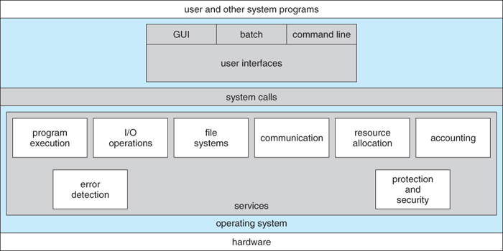
Operating-system services
A file-save action needs several OS services.
Figure: Operating System Concepts, 9th ed., ©2013, via UIC course notes
Week 2 22
Notes:
TEACHING NOTES
For saving a report: program execution runs the editor, file services organize persistent data, I/O transfers bytes, protection checks permissions, and resource allocation shares CPU and buffers. Add error detection and accounting as system-oriented services. Ask students which services a browser download uses. Original lecture explanation, source figure credited separately.
SOURCES
https://www.man7.org/linux/man-pages/man2/syscalls.2.html
https://www.cs.uic.edu/~jbell/CourseNotes/OperatingSystems/images/Chapter2/2_01_OS_Services.jpg
Original classroom explanations and exercises by this teaching adaptation. Source figures retained with acknowledgement. Charts show hypothetical examples, not measured performance.

Slide 23
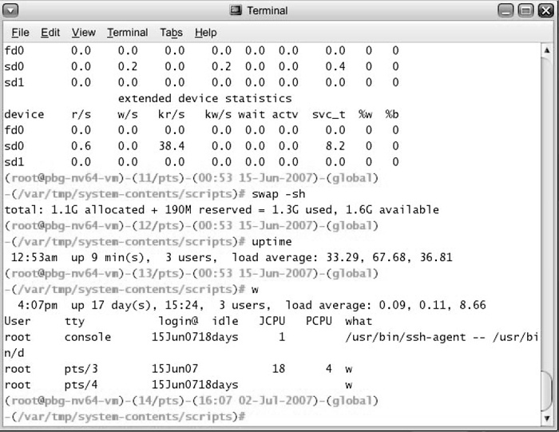
CLI and GUI
CLI: the user enters commands.
GUI: the user interacts with visual controls.
Both can request the same underlying services.
A shell is normally a user-space program.
Figure: Operating System Concepts, 9th ed., ©2013, via UIC course notes
Week 2 23
Notes:
TEACHING NOTES
Demonstrate ls or dir beside a file manager. Both request file information through OS interfaces. A CLI is not automatically more privileged. A GUI is not the kernel. A shell may execute built-ins itself and launch external programs for other commands. Examples are illustrative and platform dependent.
SOURCES
https://www.man7.org/linux/man-pages/man2/syscalls.2.html
https://www.cs.uic.edu/~jbell/CourseNotes/OperatingSystems/images/Chapter2/2_02_BourneShell.jpg
Original classroom explanations and exercises by this teaching adaptation. Source figures retained with acknowledgement. Charts show hypothetical examples, not measured performance.

Slide 24
API and system call
API: the interface a programmer uses.
System call: a controlled request to the kernel.
A library wrapper often connects the two.
Some API calls do all their work in user space.
Week 2 24
Notes:
TEACHING NOTES
Use strlen as a user-space function and write as a library interface that typically invokes a kernel write request on Linux. printf is buffered and does not necessarily invoke a syscall on every call. POSIX specifies APIs rather than one universal machine instruction sequence. Linux system-call conventions depend on the architecture.
SOURCES
https://www.man7.org/linux/man-pages/man2/syscalls.2.html
Original classroom explanations and exercises by this teaching adaptation. Source figures retained with acknowledgement. Charts show hypothetical examples, not measured performance.

Slide 25
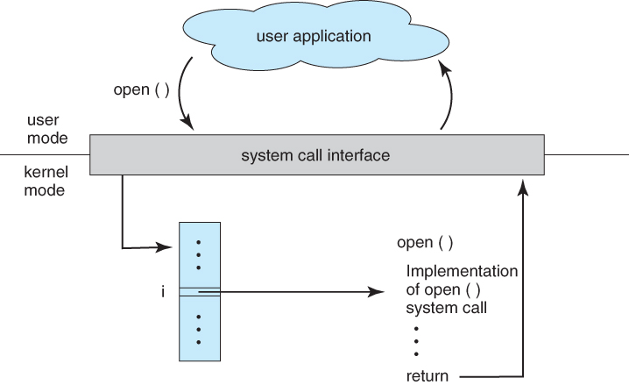
A system-call request
Application code supplies parameters.
A wrapper enters the kernel through the ABI.
The kernel dispatches and validates the request.
A result returns to the application.
Figure: Operating System Concepts, 9th ed., ©2013, via UIC course notes
Week 2 25
Notes:
TEACHING NOTES
Explain API, ABI and dispatch without memorizing syscall numbers. The source illustration uses open as its example. On contemporary Linux a library implementation may use openat or other related calls underneath. The teaching point is the boundary, not an exact one-to-one name mapping.
SOURCES
https://www.man7.org/linux/man-pages/man2/syscalls.2.html
https://www.cs.uic.edu/~jbell/CourseNotes/OperatingSystems/images/Chapter2/2_06_Open.jpg
Original classroom explanations and exercises by this teaching adaptation. Source figures retained with acknowledgement. Charts show hypothetical examples, not measured performance.

Slide 26
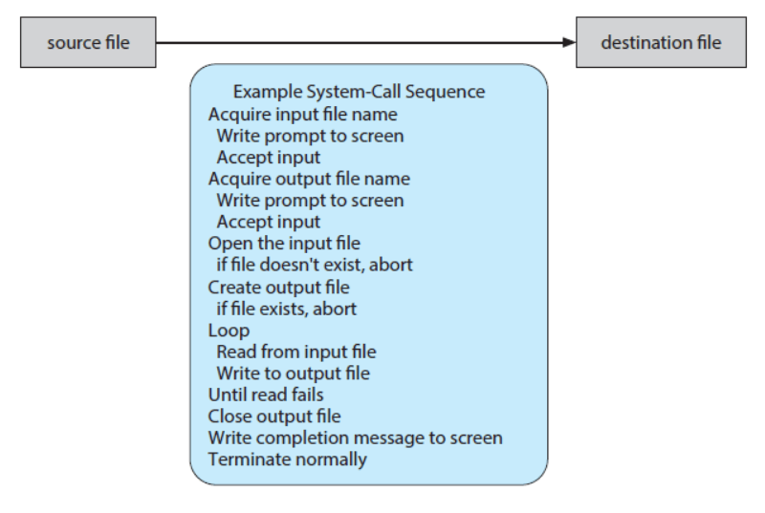

Slide 27
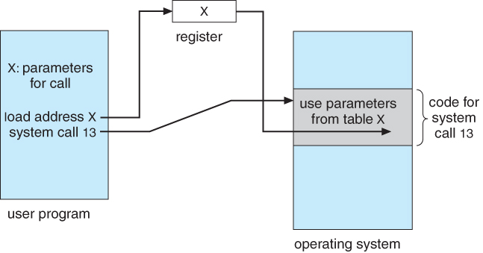
Passing parameters
Registers can carry a small argument set.
A register can point to a memory block.
Some interfaces use a stack convention.
The kernel must validate user-supplied addresses.
Figure: Operating System Concepts, 9th ed., ©2013, via UIC course notes
Week 2 26
Notes:
TEACHING NOTES
Different architectures and ABIs use different conventions. Modern Linux on x86-64 normally passes syscall arguments in registers. A pointer is an address, not proof that the buffer exists or is accessible. A write request includes a descriptor, pointer and count. Kernel validation is essential.
SOURCES
https://www.man7.org/linux/man-pages/man2/syscalls.2.html
https://www.cs.uic.edu/~jbell/CourseNotes/OperatingSystems/images/Chapter2/2_07_Passing.jpg
Original classroom explanations and exercises by this teaching adaptation. Source figures retained with acknowledgement. Charts show hypothetical examples, not measured performance.

Slide 28
System-call categories
The categories organize services for programmers.
Category | Illustrative interfaces
Process control | Create, execute, wait, exit
File and device management | open, read, write, close, ioctl
Information maintenance | Get process ID, time or attributes
Communication | Pipes, sockets, shared memory
Protection | Access checks and permission changes
Week 2 27
Notes:
TEACHING NOTES
Avoid requiring memorization of every syscall. Ask students to map operations to categories. Linux examples are given through commonly used C interfaces. Some interface names are wrappers or families. Process creation calls are only previewed here because the outline teaches fork and exec in Week 4.
SOURCES
https://www.man7.org/linux/man-pages/man2/syscalls.2.html
Original classroom explanations and exercises by this teaching adaptation. Source figures retained with acknowledgement. Charts show hypothetical examples, not measured performance.

Slide 29
Worked trace: copy a file
Open the source for reading.
Create or open the destination for writing.
Repeat: read bytes, then write those bytes.
Close descriptors and report errors.
Week 2 28
Notes:
TEACHING NOTES
Ask where the OS may reject the request: missing source, denied permission, insufficient space, invalid buffer or device error. Production code must handle partial writes and interrupted calls. This slide is a conceptual trace, not a complete file-copy program. Link each stage to the service category and privilege boundary.
SOURCES
https://www.man7.org/linux/man-pages/man2/syscalls.2.html
Original classroom explanations and exercises by this teaching adaptation. Source figures retained with acknowledgement. Charts show hypothetical examples, not measured performance.

Slide 30
Live demo: seeing system calls
On Linux, WSL or a prepared Linux VM:
strace -e trace=openat,read,write,close cat sample.txt
Observe file access and output.
Compare the command with its kernel requests.
Week 2 29
Notes:
TEACHING NOTES
Create a small sample.txt before class. strace must be installed and tracing must be permitted. Dynamic loader activity causes extra file calls. Filter output, then locate the read of sample.txt and write to descriptor 1. Output varies by system. Use a prepared screenshot or verbal trace if the classroom has Windows without Linux/WSL. Do not promise identical syscall names everywhere.
SOURCES
https://www.man7.org/linux/man-pages/man2/syscalls.2.html
Original classroom explanations and exercises by this teaching adaptation. Source figures retained with acknowledgement. Charts show hypothetical examples, not measured performance.

Slide 31
Week 2 A checkpoint
Is a shell the kernel?
Does every library function make a system call?
Why must the kernel check a buffer pointer?
Which services support saving a document?
Week 2 30
Notes:
TEACHING NOTES
Answers: normally no, no, because user input may refer to invalid or unauthorized memory, and file/I/O/protection/resource services. Ask students to describe the boundary in their own words rather than repeat terminology.
SOURCES
https://www.man7.org/linux/man-pages/man2/syscalls.2.html
Original classroom explanations and exercises by this teaching adaptation. Source figures retained with acknowledgement. Charts show hypothetical examples, not measured performance.

Slide 32
WEEK 2
Week 2: kernel design
Compare six structure choices.
Separate policy from mechanism.
Explain tradeoffs using a driver failure.
Week 2 31
Notes:
TEACHING NOTES
Proposed Week 2 B: 5 minutes retrieval, 5 minutes design goals, 20 minutes structures, 10 minutes Apple/Android, 10 minutes design scenario, 10 minutes comparison and checkpoint. Explain the categories as design models. Real systems combine several features.
SOURCES
https://www.man7.org/linux/man-pages/man2/syscalls.2.html
Original classroom explanations and exercises by this teaching adaptation. Source figures retained with acknowledgement. Charts show hypothetical examples, not measured performance.

Slide 33
Design goals, policy and mechanism
Goals include performance and reliability.
Policy decides which action to choose.
Mechanism provides the means to carry it out.
A useful design lets policy change independently.
Week 2 32
Notes:
TEACHING NOTES
Example: a scheduler policy chooses the next process. A context-switch mechanism saves and restores state. Other design goals include maintainability, security and portability. Goals can conflict. A smaller privileged core may improve fault isolation while adding communication cost. The separation is an engineering principle, not an absolute requirement.
SOURCES
https://www.man7.org/linux/man-pages/man2/syscalls.2.html
https://pages.cs.wisc.edu/~remzi/OSTEP/cpu-mechanisms.pdf
Original classroom explanations and exercises by this teaching adaptation. Source figures retained with acknowledgement. Charts show hypothetical examples, not measured performance.

Slide 34
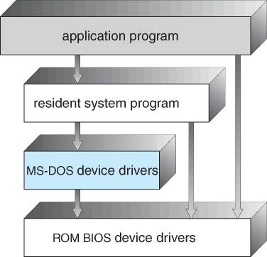
Simple structure: MS-DOS
A small system can have weak boundaries.
Applications may reach lower-level functions.
That flexibility makes protection harder.
Figure: Operating System Concepts, 9th ed., ©2013, via UIC course notes
Week 2 33
Notes:
TEACHING NOTES
MS-DOS is a historical teaching example of limited structural separation. Explain the diagram in context of early hardware and constraints rather than presenting it as a modern protected kernel design. The categories simple and monolithic overlap historically. Focus on which boundaries can be bypassed.
SOURCES
https://www.man7.org/linux/man-pages/man2/syscalls.2.html
https://www.cs.uic.edu/~jbell/CourseNotes/OperatingSystems/images/Chapter2/2_11_DOS_Structure.jpg
Original classroom explanations and exercises by this teaching adaptation. Source figures retained with acknowledgement. Charts show hypothetical examples, not measured performance.

Slide 35
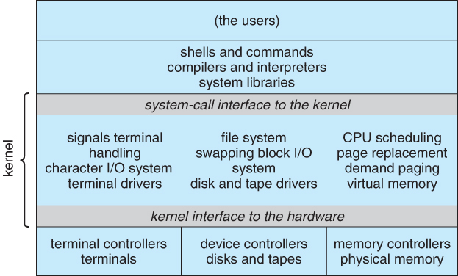
Monolithic structure
Many core services share privileged space.
Services communicate through internal calls.
A kernel bug can affect the whole system.
Linux supports a modular monolithic design.
Figure: Operating System Concepts, 9th ed., ©2013, via UIC course notes
Week 2 34
Notes:
TEACHING NOTES
The figure illustrates historical UNIX organization. Do not infer that a monolithic kernel has no internal organization. It can use clean subsystems and loadable modules. Sharing privileged space makes calls efficient but reduces isolation between kernel components. Avoid universal performance rankings.
SOURCES
https://www.man7.org/linux/man-pages/man2/syscalls.2.html
https://www.cs.uic.edu/~jbell/CourseNotes/OperatingSystems/images/Chapter2/2_12_UNIX_Structure.jpg
https://www.kernel.org/doc/html/latest/admin-guide/module-signing.html
Original classroom explanations and exercises by this teaching adaptation. Source figures retained with acknowledgement. Charts show hypothetical examples, not measured performance.

Slide 36
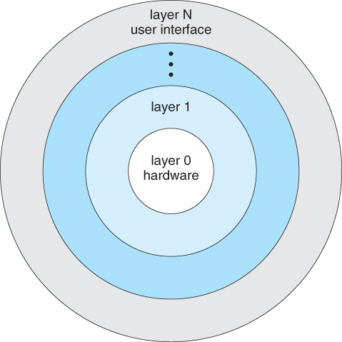
Layered structure
Each layer uses lower-level services.
Clear boundaries help reasoning and testing.
Choosing useful layers can be difficult.
Extra crossings may add cost.
Figure: Operating System Concepts, 9th ed., ©2013, via UIC course notes
Week 2 35
Notes:
TEACHING NOTES
The figure is a conceptual layered model. Higher layers provide abstractions and lower layers handle hardware-facing details. Ask: where should memory allocation sit if several layers need it? Strict layering may be inconvenient, so real systems often use partial layering.
SOURCES
https://www.man7.org/linux/man-pages/man2/syscalls.2.html
https://www.cs.uic.edu/~jbell/CourseNotes/OperatingSystems/images/Chapter2/2_13_Laered_OS.jpg
Original classroom explanations and exercises by this teaching adaptation. Source figures retained with acknowledgement. Charts show hypothetical examples, not measured performance.

Slide 37
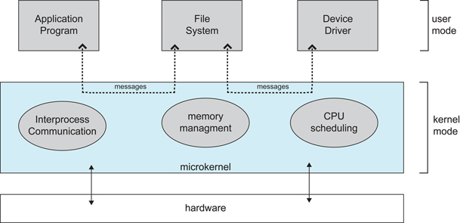
Microkernel structure
A small kernel keeps essential mechanisms.
More services run as user-space servers.
Services communicate through messages.
Isolation depends on the implemented boundaries.
Figure: Operating System Concepts, 9th ed., ©2013, via UIC course notes
Week 2 36
Notes:
TEACHING NOTES
The diagram shows application requests routed to services using a microkernel. Typical essential mechanisms include IPC, low-level address-space management and scheduling. Exact membership differs by design. A user-space driver failure may be contained, but successful recovery requires appropriate supervision and service design. Message and mode-crossing overhead varies.
SOURCES
https://www.man7.org/linux/man-pages/man2/syscalls.2.html
https://www.cs.uic.edu/~jbell/CourseNotes/OperatingSystems/images/Chapter2/2_14_microkernelArchitecture.jpg
Original classroom explanations and exercises by this teaching adaptation. Source figures retained with acknowledgement. Charts show hypothetical examples, not measured performance.

Slide 38
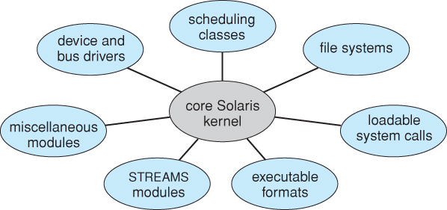
Modules
A kernel can load extensions at runtime.
Defined interfaces improve organization.
Kernel modules still execute with privilege.
Modularity alone does not isolate failures.
Figure: Operating System Concepts, 9th ed., ©2013, via UIC course notes
Week 2 37
Notes:
TEACHING NOTES
Solaris provides the source illustration, while Linux is another example. A loadable driver in kernel space can still corrupt privileged state. Distinguish a kernel module from a user-space service in a microkernel. Read-only demo: lsmod on Linux, if available.
SOURCES
https://www.man7.org/linux/man-pages/man2/syscalls.2.html
https://www.cs.uic.edu/~jbell/CourseNotes/OperatingSystems/images/Chapter2/2_15_Solaris_Modules.jpg
https://www.kernel.org/doc/html/latest/admin-guide/module-signing.html
Original classroom explanations and exercises by this teaching adaptation. Source figures retained with acknowledgement. Charts show hypothetical examples, not measured performance.

Slide 39
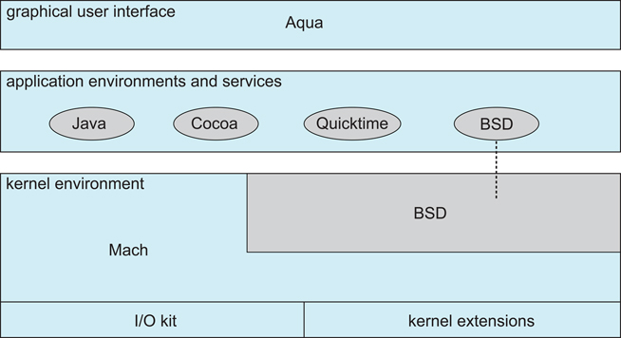
Hybrid systems: macOS and iOS
Apple’s XNU combines Mach and BSD facilities.
I/O Kit supports driver infrastructure.
The full OS includes user-space frameworks.
Hybrid is a useful teaching classification.
Figure: Operating System Concepts, 9th ed., ©2013, via UIC course notes
Week 2 38
Notes:
TEACHING NOTES
Apple documents a kernel environment containing Mach, BSD, I/O Kit, networking and file systems. iOS also uses XNU. Historical figures are conceptual, not exact current implementation maps. Some modern drivers run in user space. Avoid saying that all Mach-derived services live outside the XNU kernel.
SOURCES
https://www.man7.org/linux/man-pages/man2/syscalls.2.html
https://www.cs.uic.edu/~jbell/CourseNotes/OperatingSystems/images/Chapter2/2_16_Mac_OSX_Structure.jpg
https://developer.apple.com/library/archive/documentation/Darwin/Conceptual/KernelProgramming/Architecture/Architecture.html
Original classroom explanations and exercises by this teaching adaptation. Source figures retained with acknowledgement. Charts show hypothetical examples, not measured performance.

Slide 40
Android: stack versus kernel
Applications use framework services.
The runtime and native libraries support apps.
HAL interfaces expose device capabilities.
The Linux kernel supplies core OS mechanisms.
Level | Role
Applications / framework | User features and application services
ART / native libraries | Execution and reusable native facilities
HAL | Interfaces to device-specific capabilities
Linux kernel | Scheduling, memory, drivers and protection
Week 2 39
Notes:
TEACHING NOTES
Android is a layered platform stack with a Linux-based, modular monolithic kernel. It is not a microkernel because it has frameworks above Linux. The outline groups Android under hybrid systems, so explicitly distinguish whole-platform composition from kernel classification. ART is the runtime used in contemporary Android. This slide omits the old Dalvik-labelled textbook figure.
SOURCES
https://www.man7.org/linux/man-pages/man2/syscalls.2.html
https://developer.android.com/guide/platform
Original classroom explanations and exercises by this teaching adaptation. Source figures retained with acknowledgement. Charts show hypothetical examples, not measured performance.

Slide 41
Structure comparison
The key question is where services execute.
Structure | Main benefit | Main concern
Simple | Small and straightforward | Weak separation
Monolithic | Direct internal service calls | Large privileged failure domain
Layered | Clear dependency boundaries | Layer placement and crossings
Microkernel | More service isolation | IPC and coordination cost
Modules / hybrid | Flexible composition | Complexity and shared privilege
Week 2 40
Notes:
TEACHING NOTES
Use this table as synthesis. Categories overlap and are not mutually exclusive. A monolithic kernel can be modular. A hybrid design can be layered internally. Performance depends on implementation and workload. Do not rank structures using invented benchmark numbers.
SOURCES
https://www.man7.org/linux/man-pages/man2/syscalls.2.html
Original classroom explanations and exercises by this teaching adaptation. Source figures retained with acknowledgement. Charts show hypothetical examples, not measured performance.

Slide 42
Design discussion: a driver crashes
System A runs its driver inside the kernel.
System B runs its driver in an isolated service.
Which system can contain the failure more easily?
What else is needed to restart the driver safely?
Week 2 41
Notes:
TEACHING NOTES
Give pairs three minutes. Expected answer: B can contain the crash more easily if its memory and authority are isolated. Recovery also needs a supervisor, state restoration and a plan for interrupted requests. A cannot guarantee safe continuation after kernel memory corruption. Do not assume every microkernel recovers automatically.
SOURCES
https://www.man7.org/linux/man-pages/man2/syscalls.2.html
Original classroom explanations and exercises by this teaching adaptation. Source figures retained with acknowledgement. Charts show hypothetical examples, not measured performance.

Slide 43
WEEK 3
Week 3: processes
Distinguish a program from a process.
Explain states and the PCB.
Trace scheduling queues and scheduler roles.
Explain context switching and its cost.
Week 3 42
Notes:
TEACHING NOTES
Proposed Week 3 A covers program/process, memory, states, PCB and tracing. Week 3 B covers scheduling, queues, scheduler roles, context switching and overhead. Both map to CLO1. Quiz 1 in the outline covers Lectures 1–4, so scope its assessed content to Weeks 1–2 unless local lecture numbering differs.
SOURCES
https://pages.cs.wisc.edu/~remzi/OSTEP/cpu-intro.pdf
Original classroom explanations and exercises by this teaching adaptation. Source figures retained with acknowledgement. Charts show hypothetical examples, not measured performance.

Slide 44
Program and process
A program is stored code and data.
A process is an executing instance with state.
Two launches can create two separate processes.
Their progress and resources can differ.
Week 3 43
Notes:
TEACHING NOTES
Use a text editor launched twice. Both instances may share executable code pages but have different execution states and private writable data. A real application may use multiple processes and threads. Here we begin with one thread per process. A process remains a process while it waits and is not executing instructions.
SOURCES
https://pages.cs.wisc.edu/~remzi/OSTEP/cpu-intro.pdf
Original classroom explanations and exercises by this teaching adaptation. Source figures retained with acknowledgement. Charts show hypothetical examples, not measured performance.

Slide 45
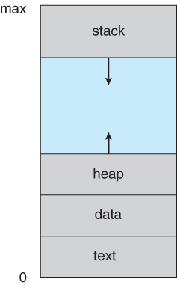
A process in memory
Code contains executable instructions.
Data stores global and static values.
Heap supports dynamic allocation.
Stack stores call frames and local state.
Figure: Operating System Concepts, 9th ed., ©2013, via UIC course notes
Week 3 44
Notes:
TEACHING NOTES
Identify an int global in the data region, malloc storage in the heap and a typical function-local variable in the stack. Modern address spaces also contain mappings and libraries. Growth direction and contiguous layout are schematic and depend on ABI and OS. Compiler optimization can keep locals in registers.
SOURCES
https://pages.cs.wisc.edu/~remzi/OSTEP/cpu-intro.pdf
https://www.cs.uic.edu/~jbell/CourseNotes/OperatingSystems/images/Chapter3/3_01_Process_Memory.jpg
Original classroom explanations and exercises by this teaching adaptation. Source figures retained with acknowledgement. Charts show hypothetical examples, not measured performance.

Slide 46
Five process states
The model describes whether a process can run.
State | Meaning
New | OS is creating the process
Ready | Runnable, waiting for CPU selection
Running | Executing on an execution unit
Waiting / blocked | Cannot proceed until an event occurs
Terminated | Execution has ended
Week 3 45
Notes:
TEACHING NOTES
Use one-core, one-thread-per-process assumptions. Ready means it can run when selected. Waiting means a needed event has not happened. Terminated means execution is finished, though bookkeeping may remain. Linux has richer state codes and these do not map one-to-one onto this model.
SOURCES
https://pages.cs.wisc.edu/~remzi/OSTEP/cpu-intro.pdf
Original classroom explanations and exercises by this teaching adaptation. Source figures retained with acknowledgement. Charts show hypothetical examples, not measured performance.

Slide 47

Process-state transitions
Dispatch selects a ready process.
Preemption returns it to ready.
A blocking request sends it to waiting.
Event completion makes it ready again.
Figure: Operating System Concepts, 9th ed., ©2013, via UIC course notes
Week 3 46
Notes:
TEACHING NOTES
Walk through every labelled edge in the source diagram. Under the basic model, waiting does not move straight to running. It becomes ready and then the scheduler dispatches it. Ready does not normally move to waiting without first executing a blocking action. Termination can also arise from external actions in richer models.
SOURCES
https://pages.cs.wisc.edu/~remzi/OSTEP/cpu-intro.pdf
https://www.cs.uic.edu/~jbell/CourseNotes/OperatingSystems/images/Chapter3/3_02_ProcessState.jpg
Original classroom explanations and exercises by this teaching adaptation. Source figures retained with acknowledgement. Charts show hypothetical examples, not measured performance.

Slide 48
Worked trace: editor saves a file
A ready editor receives CPU time.
It issues a blocking disk request.
Another process uses the CPU.
Disk completion wakes the editor.
The scheduler later selects the editor.
Week 3 47
Notes:
TEACHING NOTES
Ask students to write the state after each event. Answer: running, waiting, editor remains waiting while another runs, ready, running. Completion of disk I/O does not guarantee immediate CPU time. The trace assumes a genuinely blocking request, because buffered file operations may return earlier.
SOURCES
https://pages.cs.wisc.edu/~remzi/OSTEP/cpu-intro.pdf
Original classroom explanations and exercises by this teaching adaptation. Source figures retained with acknowledgement. Charts show hypothetical examples, not measured performance.

Slide 49
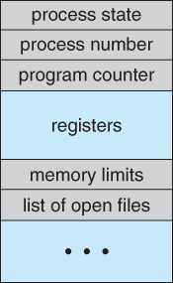
Process Control Block
The OS needs a record for each process.
Identity and state describe the process.
Saved CPU context supports later resumption.
Resource references connect it to memory and I/O.
Figure: Operating System Concepts, 9th ed., ©2013, via UIC course notes
Week 3 48
Notes:
TEACHING NOTES
Use the PCB as an organized record rather than a magic box. Discuss PID, state, saved PC/registers, scheduling metadata, memory-management references, accounting and I/O information. Actual kernels spread information across related structures. Linux task_struct is a useful implementation analogy, not an exact match to a textbook PCB.
SOURCES
https://pages.cs.wisc.edu/~remzi/OSTEP/cpu-intro.pdf
https://www.cs.uic.edu/~jbell/CourseNotes/OperatingSystems/images/Chapter3/3_03_PCB.jpg
Original classroom explanations and exercises by this teaching adaptation. Source figures retained with acknowledgement. Charts show hypothetical examples, not measured performance.

Slide 50
PCB exercise: what must survive?
P1 stops with PC = 120 and register R1 = 7.
P2 runs and changes the CPU registers.
P1 later resumes.
What must the OS restore for P1?
Week 3 49
Notes:
TEACHING NOTES
Answer: P1 execution context including its correct PC, R1 and other required registers, stack pointer and processor state. Its memory mapping or address-space context must also be selected as necessary. The OS restores P1 state, not the register values P2 left behind. Illustrative values are arbitrary. Saving only the PC is insufficient.
SOURCES
https://pages.cs.wisc.edu/~remzi/OSTEP/cpu-intro.pdf
Original classroom explanations and exercises by this teaching adaptation. Source figures retained with acknowledgement. Charts show hypothetical examples, not measured performance.

Slide 51
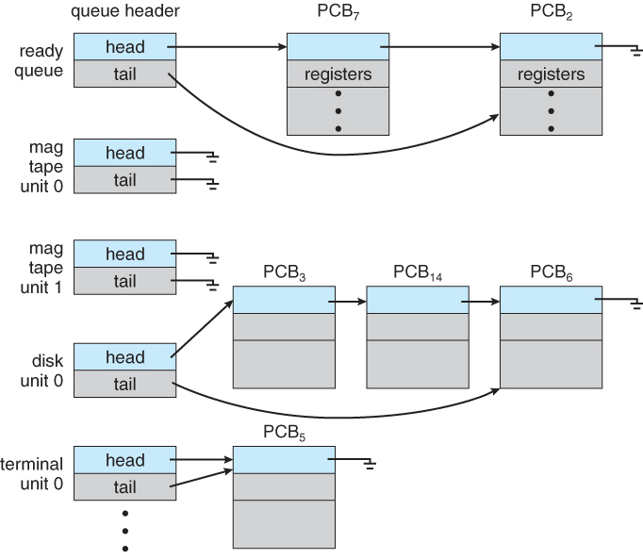
Process scheduling and queues
The ready queue holds runnable work.
Wait queues hold processes awaiting events.
The scheduler chooses work for each execution unit.
Queue organization depends on OS policy.
Figure: Operating System Concepts, 9th ed., ©2013, via UIC course notes
Week 3 50
Notes:
TEACHING NOTES
Textbook diagrams often show one CPU and one ready queue. Modern kernels may have per-CPU run queues and other arrangements. A ready queue need not be FIFO. Device and event queues are a conceptual way to group waits. CPU-bound and I/O-bound behavior influences scheduling goals.
SOURCES
https://pages.cs.wisc.edu/~remzi/OSTEP/cpu-intro.pdf
https://www.cs.uic.edu/~jbell/CourseNotes/OperatingSystems/images/Chapter3/3_05_Queues.jpg
Original classroom explanations and exercises by this teaching adaptation. Source figures retained with acknowledgement. Charts show hypothetical examples, not measured performance.

Slide 52
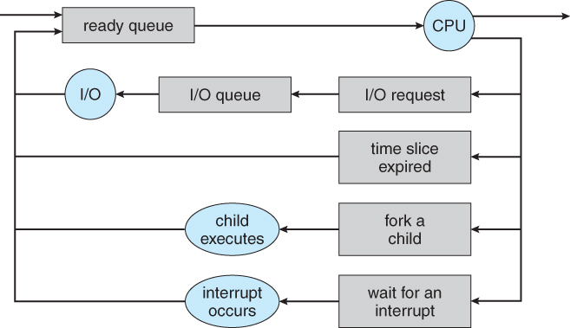
Queue movement
A dispatched process uses the CPU.
It can block, be preempted or finish.
A completed wait returns it to runnable work.
Figure: Operating System Concepts, 9th ed., ©2013, via UIC course notes
Week 3 51
Notes:
TEACHING NOTES
Track one process around the queueing diagram with a pointer. Ask a student to identify the path for a timer expiry and another for disk I/O. Queue changes correspond to process-state changes. In later lectures students will compare algorithms for selecting an item from runnable work.
SOURCES
https://pages.cs.wisc.edu/~remzi/OSTEP/cpu-intro.pdf
https://www.cs.uic.edu/~jbell/CourseNotes/OperatingSystems/images/Chapter3/3_06_QueueingDiagram.jpg
Original classroom explanations and exercises by this teaching adaptation. Source figures retained with acknowledgement. Charts show hypothetical examples, not measured performance.

Slide 53
Long-, medium- and short-term schedulers
These are textbook responsibilities.
Role | Decision | Typical timescale
Long-term | Which jobs enter the active set? | Infrequent admission
Medium-term | Which processes suspend or resume? | When load or memory requires
Short-term | Which ready task runs next? | Frequent scheduling points
Week 3 52
Notes:
TEACHING NOTES
Long-term admission selects work to enter the active workload, common in batch descriptions. Medium-term scheduling concerns suspension or swapping and active-set size. Short-term scheduling selects runnable work for CPU execution. Modern desktop/server OSes may not have separately named components for all three roles.
SOURCES
https://pages.cs.wisc.edu/~remzi/OSTEP/cpu-intro.pdf
Original classroom explanations and exercises by this teaching adaptation. Source figures retained with acknowledgement. Charts show hypothetical examples, not measured performance.

Slide 54
Suspension and waiting
Waiting describes inability to proceed yet.
Suspension removes a process from active execution.
A suspended process may be ready or waiting.
The five-state model omits this distinction.
Week 3 53
Notes:
TEACHING NOTES
Introduce suspension only to explain the medium-term scheduler. Traditional swapping can move process memory out of RAM. Modern virtual-memory systems often page individual regions rather than swap entire processes. A wait condition can finish while the process remains suspended. Avoid expanding into a full seven-state model unless time permits.
SOURCES
https://pages.cs.wisc.edu/~remzi/OSTEP/cpu-intro.pdf
Original classroom explanations and exercises by this teaching adaptation. Source figures retained with acknowledgement. Charts show hypothetical examples, not measured performance.

Slide 55
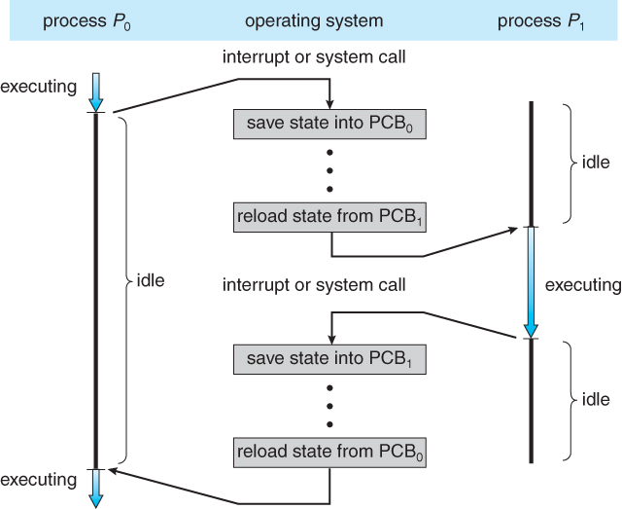
Context switching
Save the outgoing execution context.
Update its state and scheduling information.
Select the next runnable task.
Restore its context and resume execution.
Figure: Operating System Concepts, 9th ed., ©2013, via UIC course notes
Week 3 54
Notes:
TEACHING NOTES
The source diagram shows P0 and P1 alternating with operating-system work between them. A full context switch involves scheduler/dispatcher work as well as architecture-specific state handling. Not all switches require the same address-space changes. Cache and TLB effects can add indirect costs.
SOURCES
https://pages.cs.wisc.edu/~remzi/OSTEP/cpu-intro.pdf
https://www.cs.uic.edu/~jbell/CourseNotes/OperatingSystems/images/Chapter3/3_04_ProcessSwitch.jpg
https://pages.cs.wisc.edu/~remzi/OSTEP/cpu-mechanisms.pdf
Original classroom explanations and exercises by this teaching adaptation. Source figures retained with acknowledgement. Charts show hypothetical examples, not measured performance.

Slide 56
Mode switch and context switch
They answer different questions.
Question | Mode switch | Context switch
What changes? | CPU privilege level | Executing task and saved context
Must process identity change? | No | For a process switch, yes
Example | System call, same task returns | P1 stops and P2 resumes
Week 3 55
Notes:
TEACHING NOTES
Example 1: getpid enters kernel execution and returns for the same task. Example 2: a blocking read enters the kernel and the scheduler runs another task. Example 3: an interrupt handler returns without rescheduling. A mode transition and a task change may occur together but neither term is a synonym for the other.
SOURCES
https://pages.cs.wisc.edu/~remzi/OSTEP/cpu-intro.pdf
https://pages.cs.wisc.edu/~remzi/OSTEP/cpu-mechanisms.pdf
Original classroom explanations and exercises by this teaching adaptation. Source figures retained with acknowledgement. Charts show hypothetical examples, not measured performance.

Slide 57
Worked example: switch overhead
Each cycle has q ms useful work and s ms switching.
Assume continuous runnable work.
Overhead fraction = s / (q + s).
If s = 0.1 ms, compare q = 1, 5 and 10 ms.
Week 3 56
Notes:
TEACHING NOTES
Student calculation: q=1 gives 0.1/1.1 = 9.09%, q=5 gives 0.1/5.1 = 1.96%, q=10 gives 0.1/10.1 = 0.99%. These are hypothetical direct costs with one switch per cycle. They exclude other kernel work and indirect cache/TLB effects. Some schedulers may avoid a switch if the same task continues.
SOURCES
https://pages.cs.wisc.edu/~remzi/OSTEP/cpu-intro.pdf
https://pages.cs.wisc.edu/~remzi/OSTEP/cpu-mechanisms.pdf
Original classroom explanations and exercises by this teaching adaptation. Source figures retained with acknowledgement. Charts show hypothetical examples, not measured performance.

Slide 58
Overhead and responsiveness
Longer useful runs reduce switch overhead.
Shorter slices can reduce delay for runnable tasks.
A scheduler balances competing goals.
Hypothetical model: s = 0.1 ms, one switch after each useful run
Week 3 57
Notes:
TEACHING NOTES
Reveal calculated values after the exercise. Avoid claiming that the graph identifies an optimal quantum. Response depends on workload, number of runnable tasks, scheduling policy and other costs. Full round-robin evaluation is reserved for Week 7.
SOURCES
https://pages.cs.wisc.edu/~remzi/OSTEP/cpu-intro.pdf
Original classroom explanations and exercises by this teaching adaptation. Source figures retained with acknowledgement. Charts show hypothetical examples, not measured performance.

Slide 59
Live demo: process state on Linux
ps -eo pid,ppid,stat,comm
Compare IDs and states of real processes.
Use sleep 30 as a simple waiting example.
Observe Task Manager if Linux is unavailable.
Week 3 58
Notes:
TEACHING NOTES
Linux R means running or runnable, S interruptible sleep, D uninterruptible sleep, T stopped and Z zombie. These do not map one-to-one to the five-state diagram. The ps process itself may appear R. sleep waits for a timer, so waiting is broader than disk I/O. Zombie handling is preview only and belongs with Week 4 process creation.
SOURCES
https://pages.cs.wisc.edu/~remzi/OSTEP/cpu-intro.pdf
https://www.man7.org/linux/man-pages/man1/ps.1.html
Original classroom explanations and exercises by this teaching adaptation. Source figures retained with acknowledgement. Charts show hypothetical examples, not measured performance.

Slide 60
Week 3 checkpoint
Ready versus waiting: what is missing?
Does disk completion guarantee immediate execution?
Why save registers as well as the PC?
Which scheduler chooses the next runnable task?
Can a system call return without changing tasks?
Week 3 59
Notes:
TEACHING NOTES
Answers: ready lacks CPU selection, waiting lacks its required event. No, completion usually makes the task runnable. Register state is needed to continue the computation correctly. The short-term scheduler chooses next runnable work. Yes, the same task can return from a syscall. Ask students to explain the connection between all five answers.
SOURCES
https://pages.cs.wisc.edu/~remzi/OSTEP/cpu-intro.pdf
Original classroom explanations and exercises by this teaching adaptation. Source figures retained with acknowledgement. Charts show hypothetical examples, not measured performance.

Slide 61
Integrated scenario
An editor, compiler and music player share one core.
The editor blocks on I/O.
A timer interrupts the compiler.
The scheduler selects the music player.
Explain the states, privilege changes and saved data.
Week 3 60
Notes:
TEACHING NOTES
Expected narrative: editor running becomes waiting on blocking I/O. The compiler can run. Timer interrupt triggers handler/kernel execution. If music is selected, compiler running becomes ready and music ready becomes running. Save compiler context and restore music context. Editor I/O completion later makes editor ready. Several tasks make concurrent progress without parallel CPU execution.
SOURCES
https://pages.cs.wisc.edu/~remzi/OSTEP/cpu-intro.pdf
Original classroom explanations and exercises by this teaching adaptation. Source figures retained with acknowledgement. Charts show hypothetical examples, not measured performance.

Slide 62
Reading and visual credits
Course text: Operating System Concepts, 9th ed., Ch. 1–3
Stallings: chapters specified in your outline
Supplement: OSTEP, process and CPU-mechanism chapters
Technical checks: Intel, Linux, Apple and Android docs
AR332 61
Notes:
TEACHING NOTES
Figures: Silberschatz, Galvin and Gagne, Operating System Concepts, 9th ed., ©2013, retrieved from John Bell’s UIC course-note pages. Educational teaching adaptation with added explanations and exercises. The prescribed textbook in the uploaded outline satisfies the publisher’s classroom-slide use condition. Full source URLs appear in relevant slide notes and the accompanying guide. Charts use explicitly hypothetical teaching data. Sources accessed 5 October 2026.
SOURCES
https://os-book.com/OS9/slide-dir/index.html
Original classroom explanations and exercises by this teaching adaptation. Source figures retained with acknowledgement. Charts show hypothetical examples, not measured performance.

